Slide 1
Breaking AES
Abusing blind trust in StackOverflow code
By Philippe Dugré

Slide 2
Requirements
Python3
flask
base64
cryptography
(requests)
A (preferably recent) web browser
A scripting environment(python recommended)

Slide 3
Why?
People always think AES is inherently safe.
People like to paste code from github while having no clue what they’re doing.
We won’t attack the cipher itself, but how it is used.
None of these attacks works only on AES

Slide 4
Mathematics requirements
5th grade mathematics: +, -, *, /
XOR:
a ^ a = 0
a ^ 0 = a
a ^ b = c ^ d ⇔ a = c ^ d ^ d ⇔ 0 = a ^ b ^ c ^ d

Slide 5
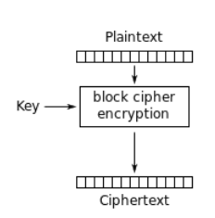
Block Cipher
AES is a block cipher. In itself, AES can only encrypt blocks of 16 bytes.
Source: https://en.wikipedia.org/wiki/Block_cipher_mode_of_operation

Slide 6
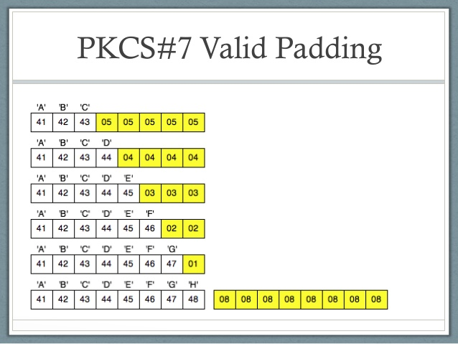
PKCS7 padding
If our text length is not a multiple of 16, we need to pad it.
If we need to add 1 bytes, add 1 bytes of 0x01
If we need to add 2 bytes, add 2 bytes of 0x02
And so on.
If our text length is a mutliple of 16, add 16 bytes of 0x10
Source: https://i.stack.imgur.com/LTvZJ.jpg

Slide 7
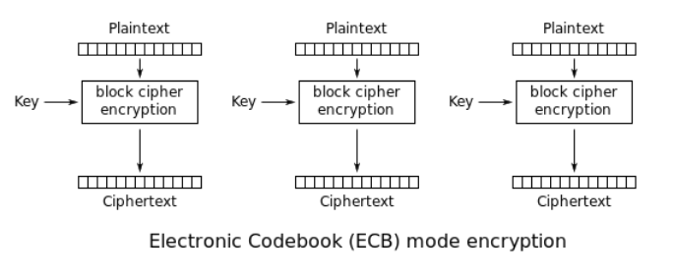
Block Modes
Block modes are a method to encrypt multiple blocks, instead of a single one.
Example: ECB(never use this)
Source: https://en.wikipedia.org/wiki/Block_cipher_mode_of_operation

Slide 8
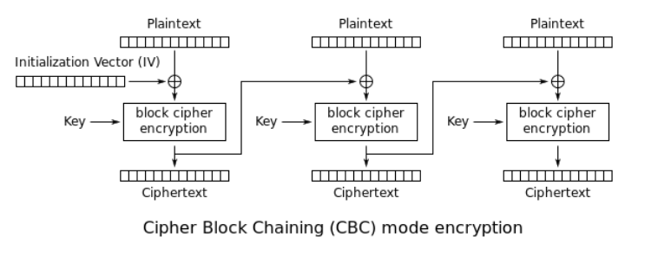
CBC
CBC is the most widely used block cipher mode:
Source: https://en.wikipedia.org/wiki/Block_cipher_mode_of_operation

Slide 9
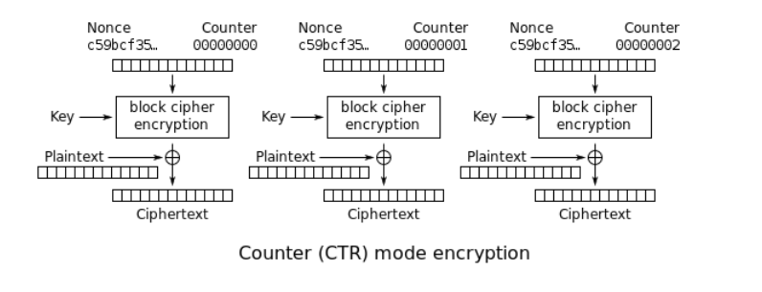
CTR
CTR transforms AES into a Stream Cipher. AES-CTR is mostly vulnerable to the same attacks as other stream cipher like RC4 or ChaCha20:
Source: https://en.wikipedia.org/wiki/Block_cipher_mode_of_operation

Slide 10
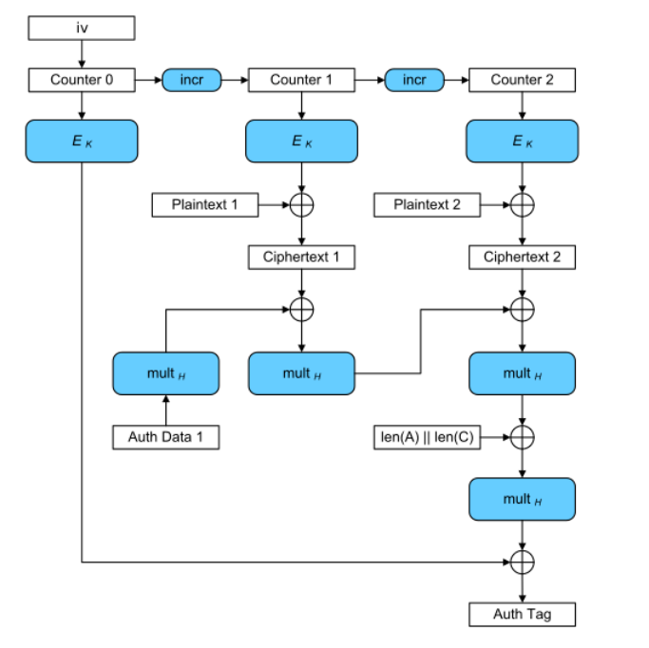
GCM
Galois/Counter Mode. More complicated, but also checks that the encrypted data and a plaintext “TAG” hasn’t been tampered.
Source: https://en.wikipedia.org/wiki/Galois/Counter_Mode

Slide 11
Have fun!
http://XXX.XXX.XXX.XXX:5000-5007
docker-compose up
python3 ctr1.py
Easy | Medium-easy | Medium-hard | Hard
CTR1 GCM1 ECB1 | ECB2 CBC2 | CBC1 CTR2 | CBC3 CBC4

